Slide 1
Bangladeshi Currency Detection
Using YOLO V4

Slide 2
Contributors
Name | Identification Number
Shakhawat Anol | 17201017
Ashik E Elahi | 17201028
Imtiyaz Hassan Ratul | 17201033
Project GitHub Link
https://github.com/Cysgod7/Money-Detection

Slide 3
Project Details
Money has very significant effect in our day to day life. They add measured value to everything that is tangible in our life. We handle lots of money everyday by any mean. So, for human recognizing all types/forms of money is important and we all can do that. But how about identifying multiple stacks of different types of money. So, we are aimed to create a system that can automatically detect plane, folded or teared currency.

Slide 4
Tools
Labelimg-Master
To create a data-set using image of different forms of currency, that we will use to train our system
Yolo
A real time object recognition algorithm, To detect currency(object) from a photograph.

Slide 5
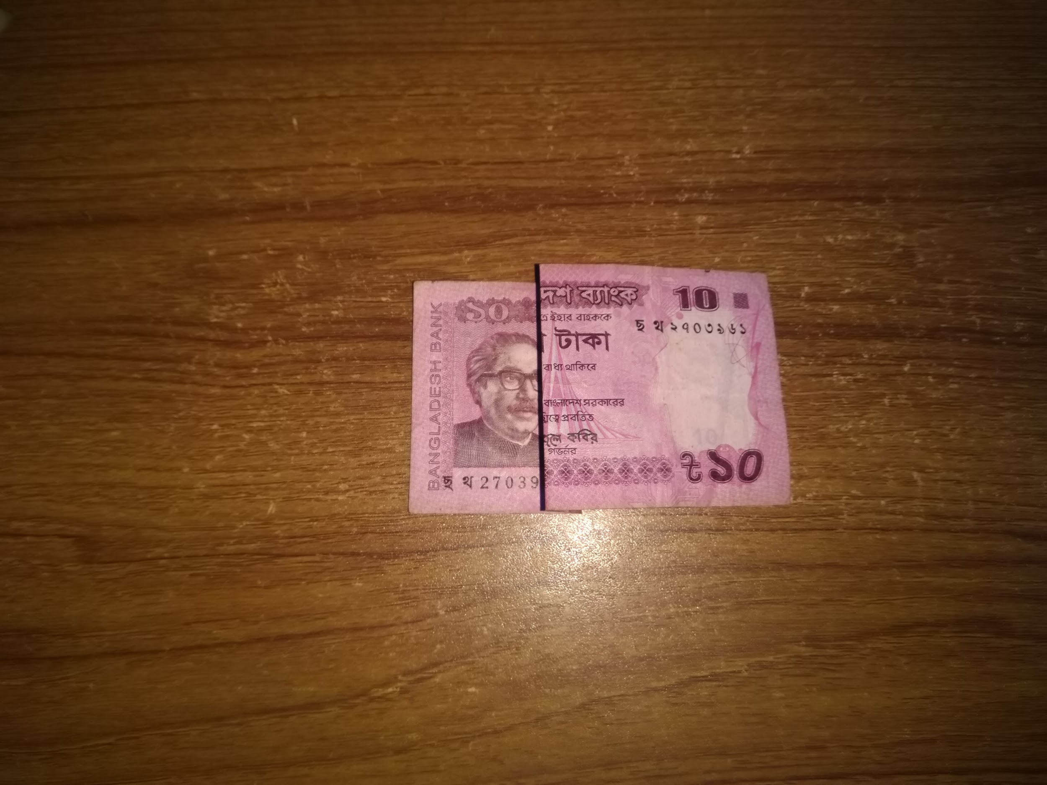
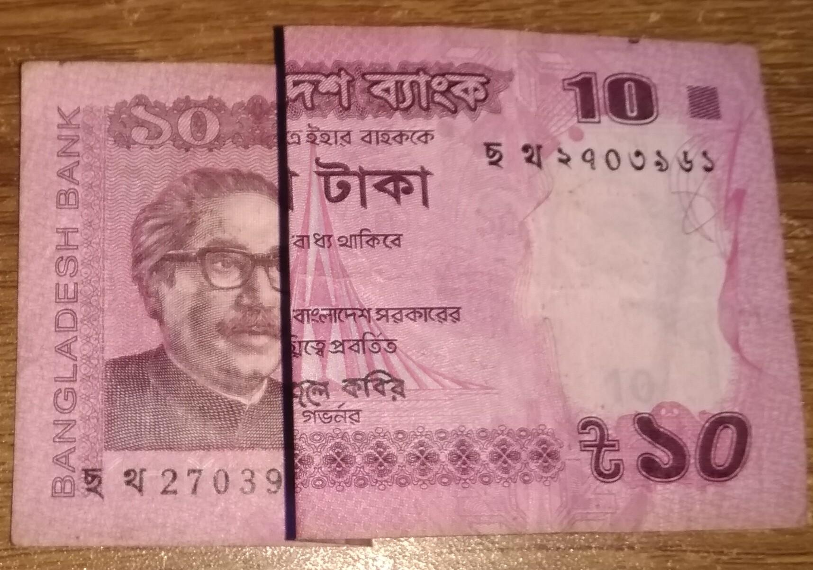
Input
Output
Machine Returns : 10 taka

Slide 6
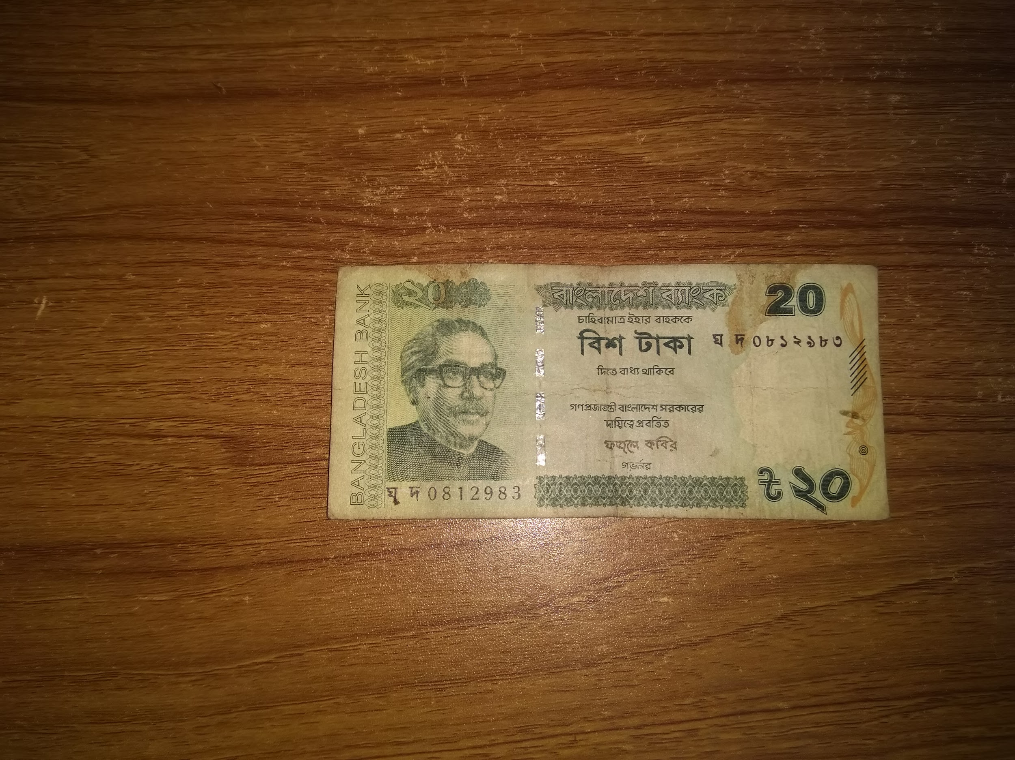
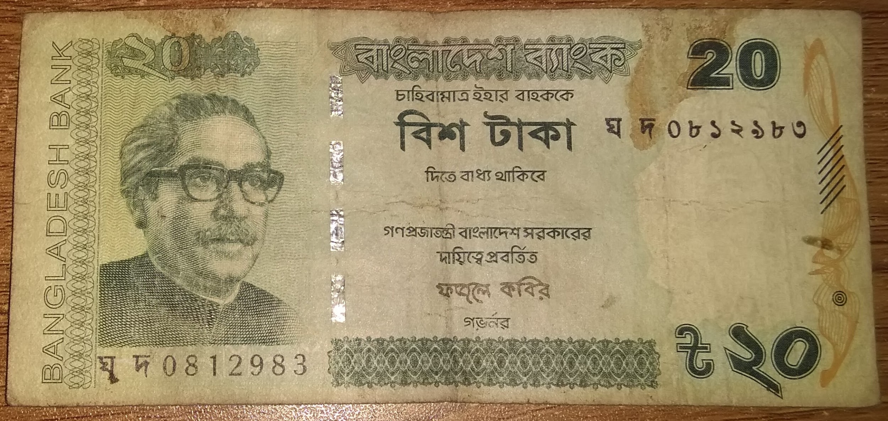
Input
Output
Machine Returns : 20 taka

Slide 7
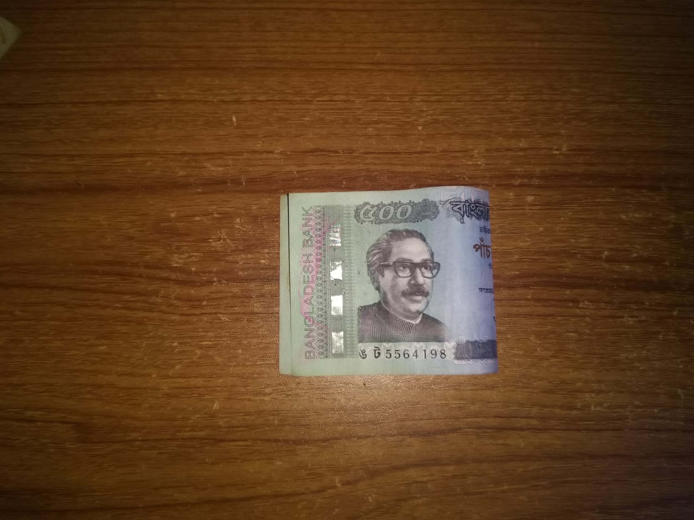
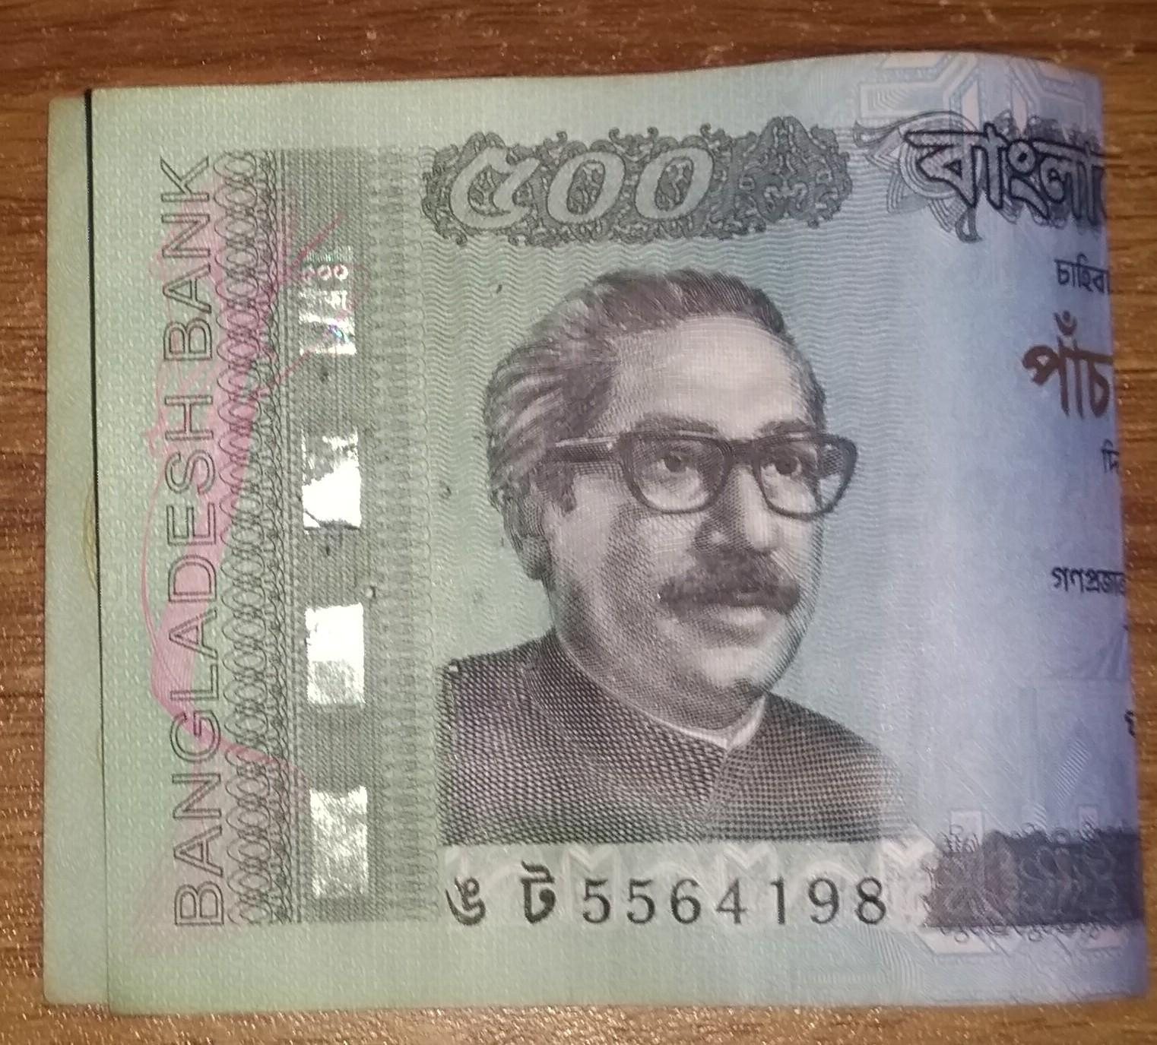
Input
Output
Machine Returns : 500 taka

Slide 8
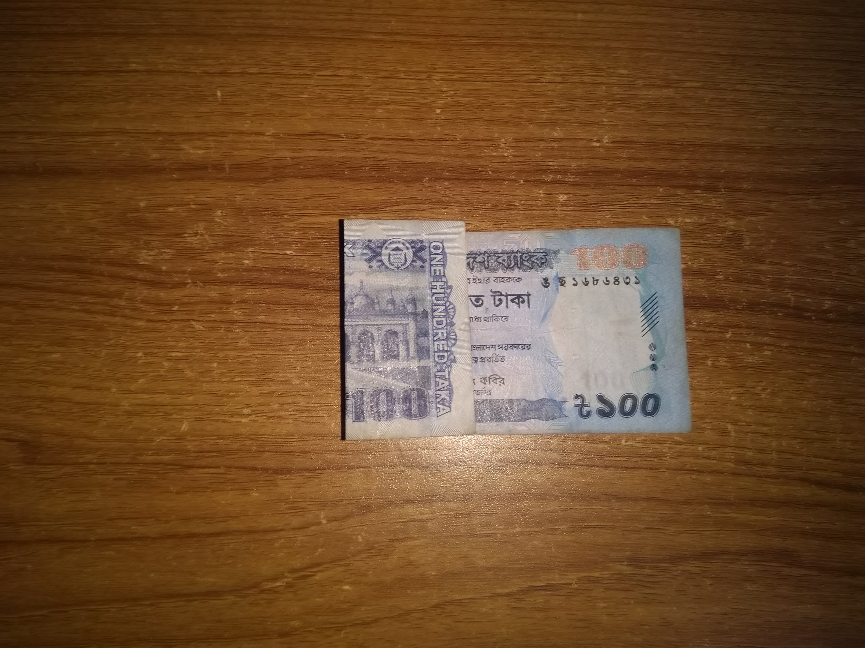
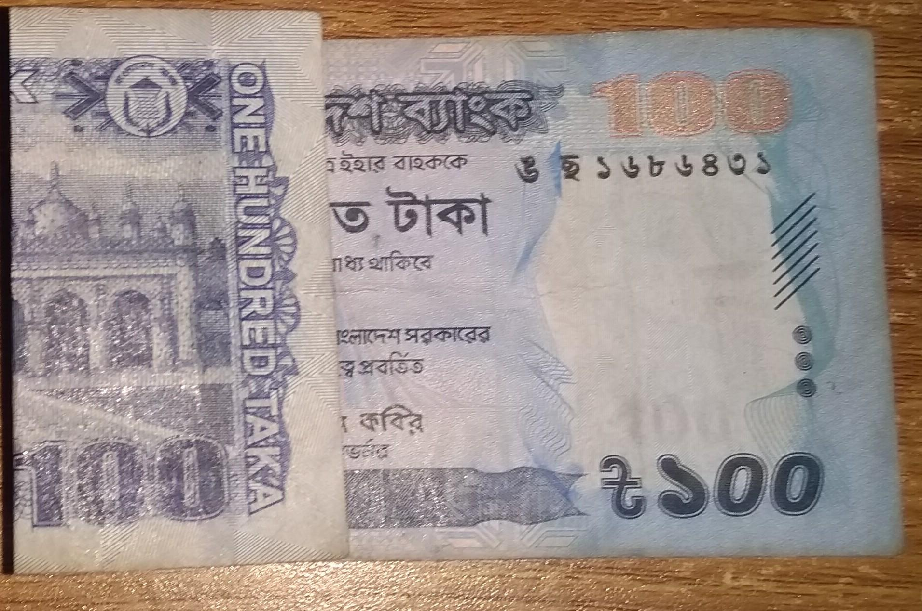
Input
Output
Machine Returns : 100 taka

Slide 9
Thank you

